Slide 1
“Capstone Project - The Battle of Neighborhoods” - Seoul, Korea -
Annie
Mar 31, 2019

Slide 2
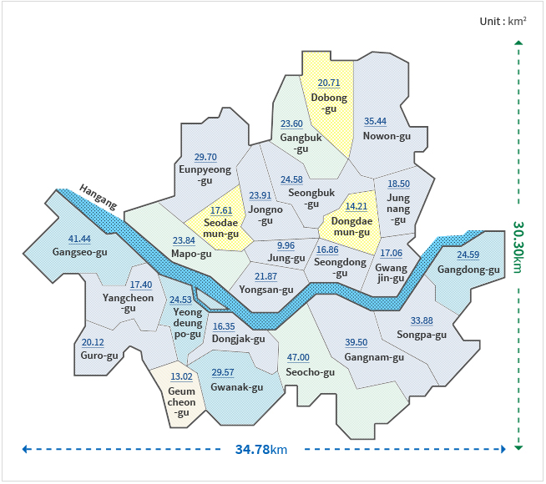
Problem
Where to go in Seoul ?

Slide 3
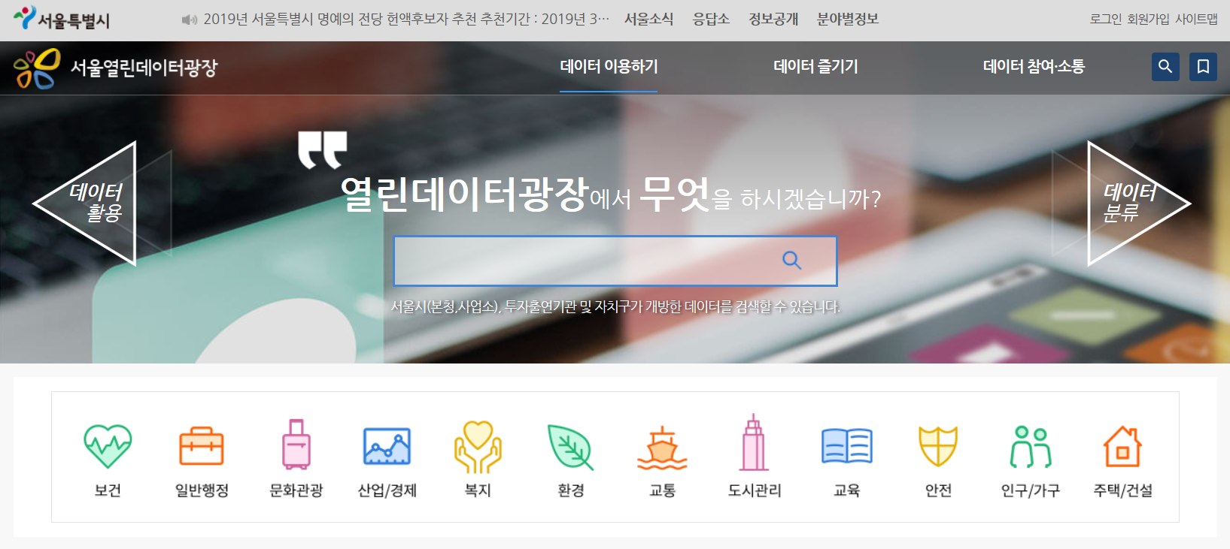
Data
Seoul Open Dataset (https://data.seoul.go.kr )

Slide 4
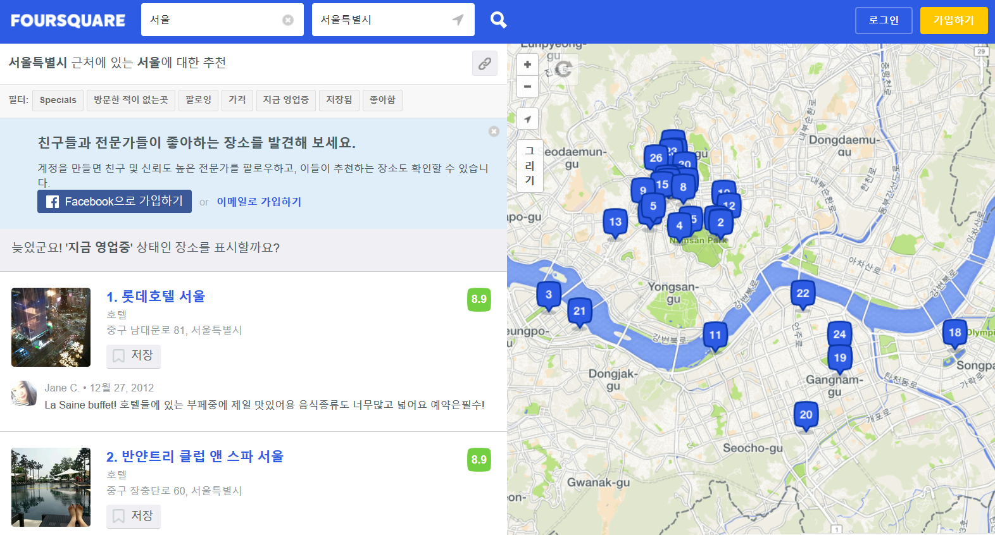
Location Data
Using Foursquare API

Slide 5
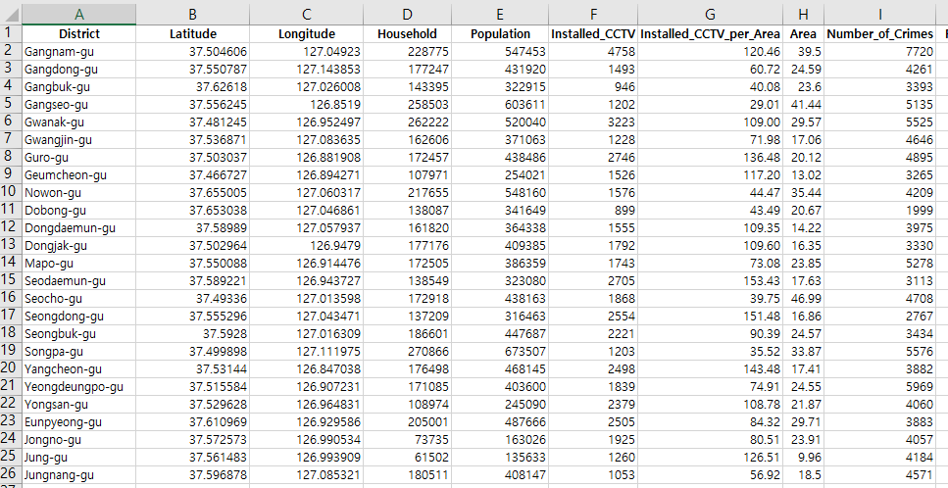
Data Preparation

Slide 6
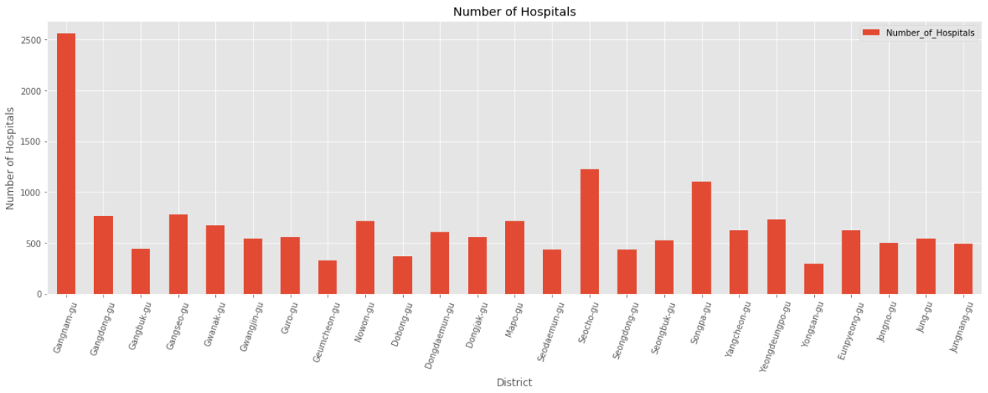
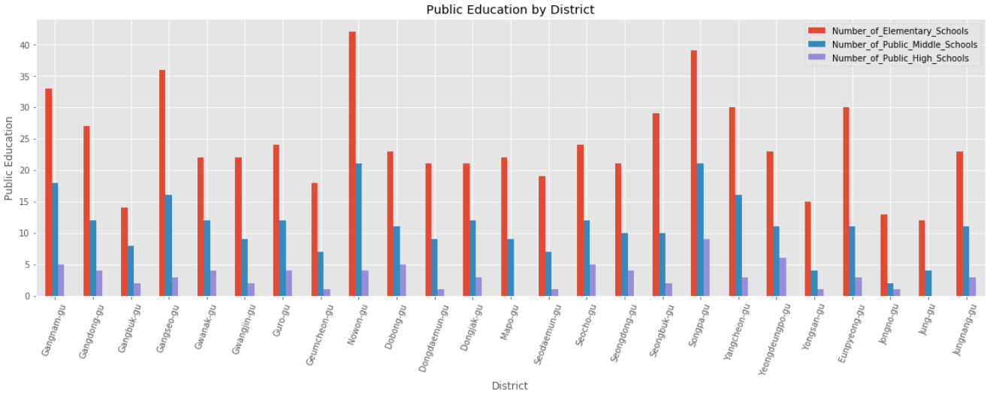
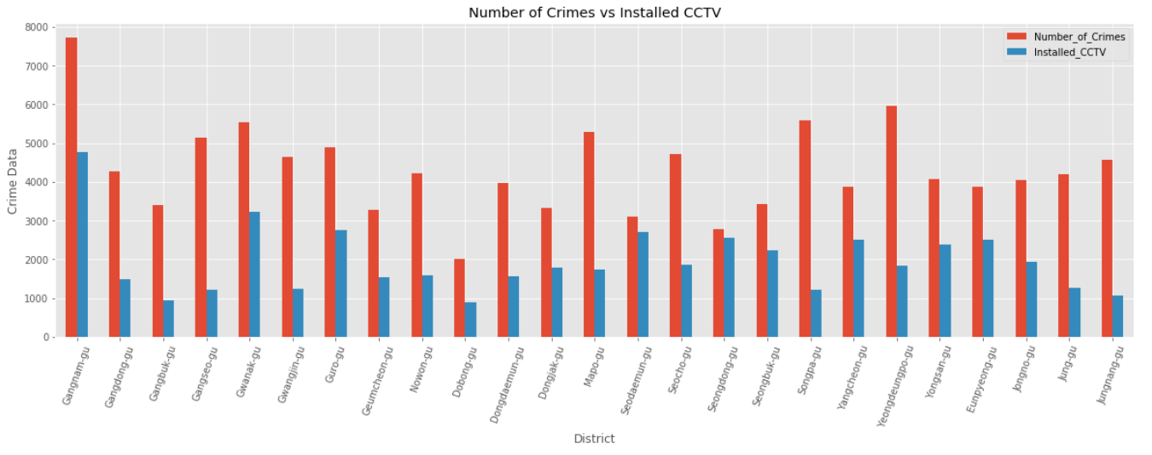
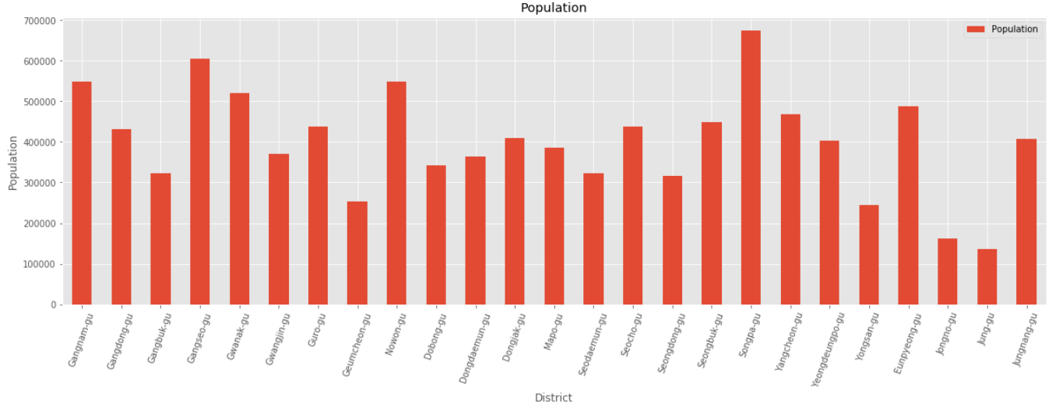
Data Exploration

Slide 7
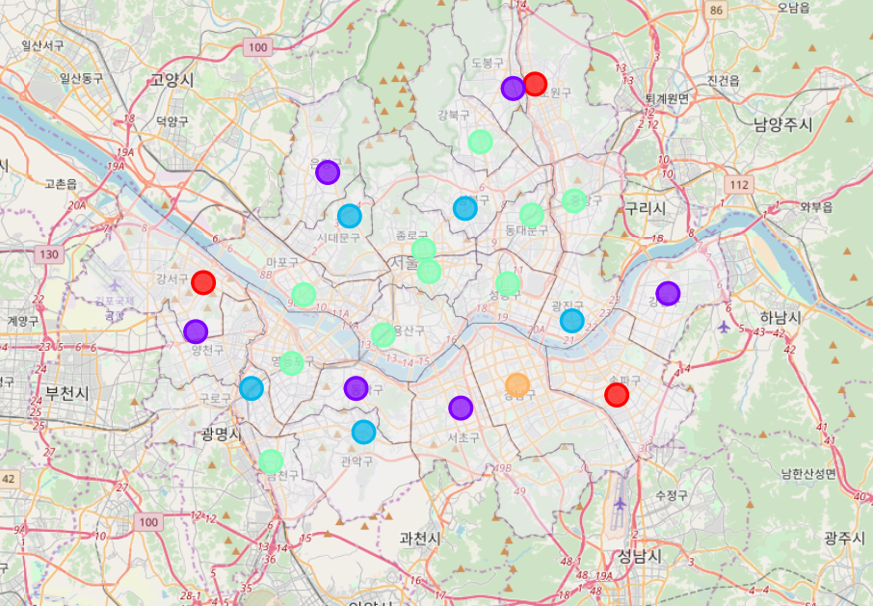
K-means Clustering

Slide 8
THANK YOU

